Slide 1
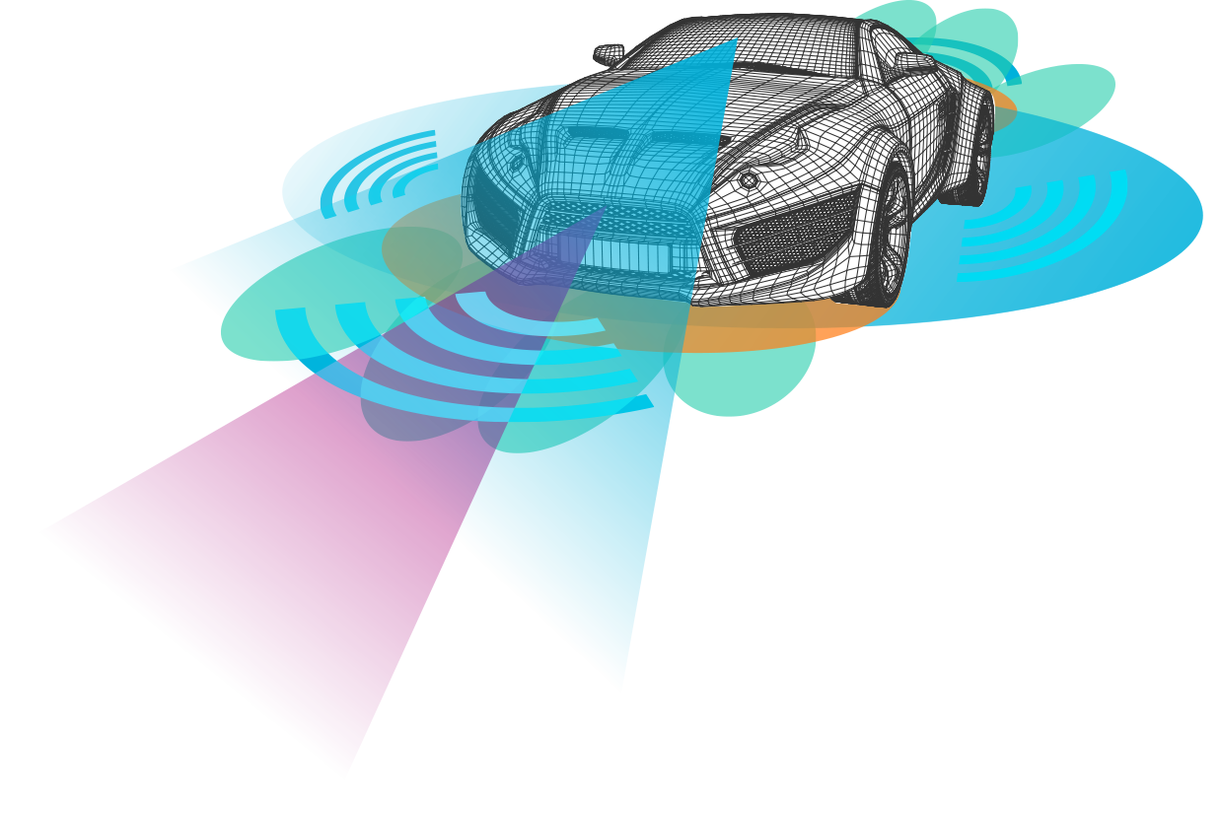
Car LiDaR

Slide 2
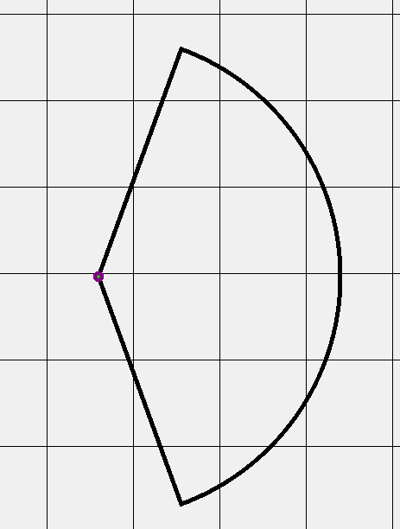
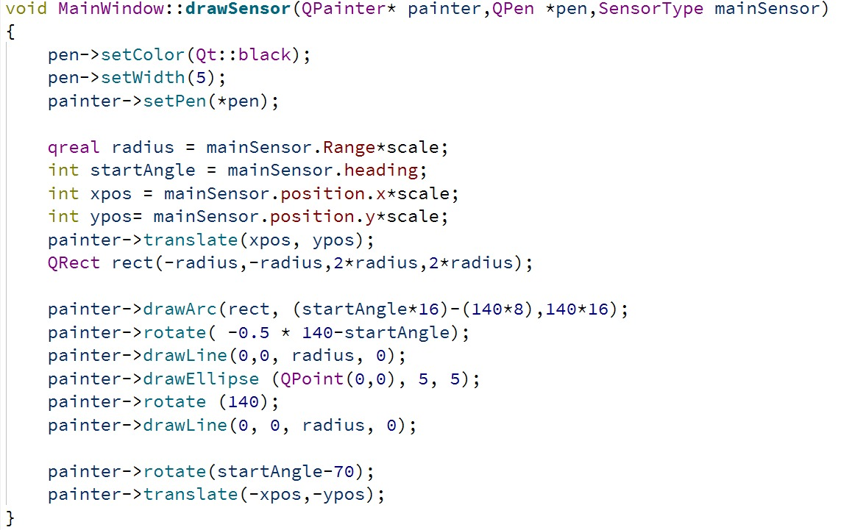
Sensor Visualization

Slide 3
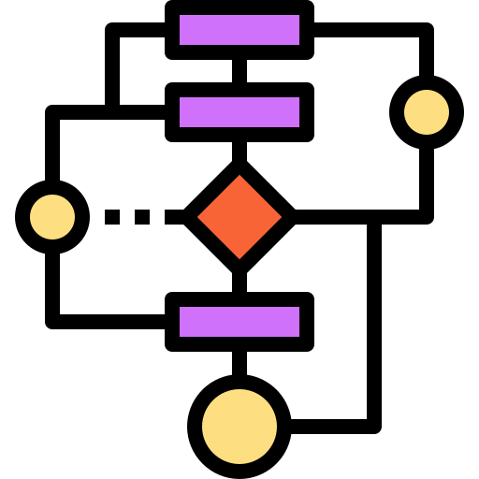
Algorithm explanation

Slide 4





Algorithm explanation
FindClosestPoint function:
$V_{1 } :first closest point$ → ($x_{1}, y_{1})$
$$V_{1}$$
$V_{2 } :second closest point$ → ($x_{2}, y_{2})$
Ᾱ
$\text{Ᾱ} :direction vector of V_{1 }V_{2 } line$→ (x2 – x1, y2 – y1) → ($d_{x},d_{y}$)
ῡ
$$\overset{⃑}{P}$$
$\text{ῡ} :direction vector of V_{1 }Q line$ → ($X_{Q}−X_{1},Y_{Q}−Y_{1})$
$$Q$$
$$V_{2}$$
$\overset{⃑}{P}= \frac{\overset{⃑}{U}.\overset{⃑}{A}}{{|\left|\overset{⃑}{A}\right||}^{2}}$ . $\overset{⃑}{A}$

Slide 5
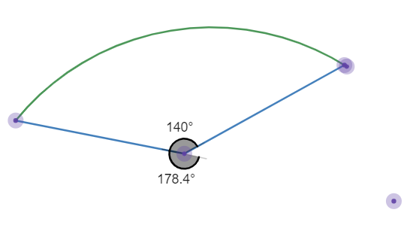
FIELD OF VIEW Angle
Calculate if angle between minimum position point and Center of sensor is in range of Sensor view (140 degree).
Example : Sensor Heading : 0 degree.
Check if angle between sensor and Point is in
range : (-70 , 70)

Slide 6
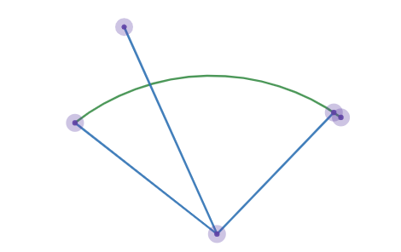
FIELD OF VIEW Distance
If angle is in field of view.
Check if distance is less than arc Radius.
$$Distance= \sqrt{{(X Sensor − X min)}^{2}+{(Y Sensor − Y min)}^{2} }$$

Slide 7
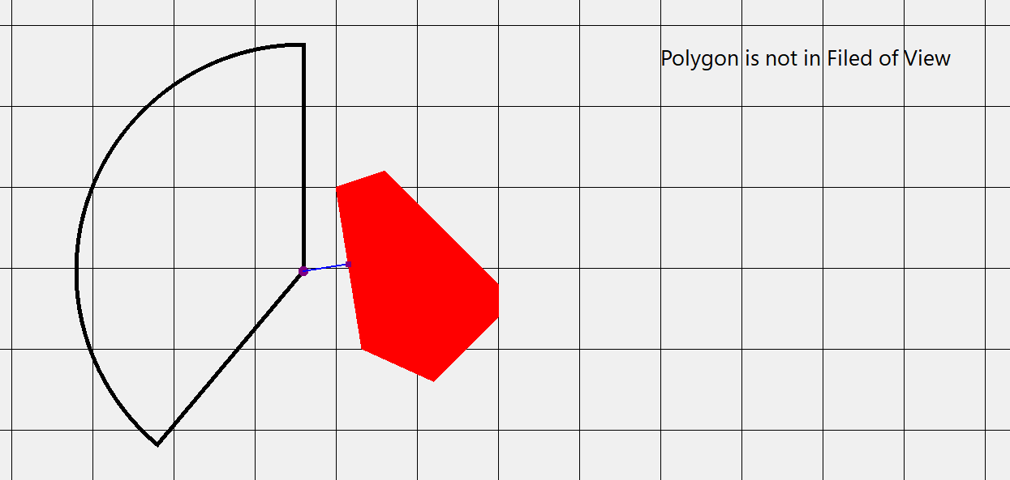
Example 1

Slide 8
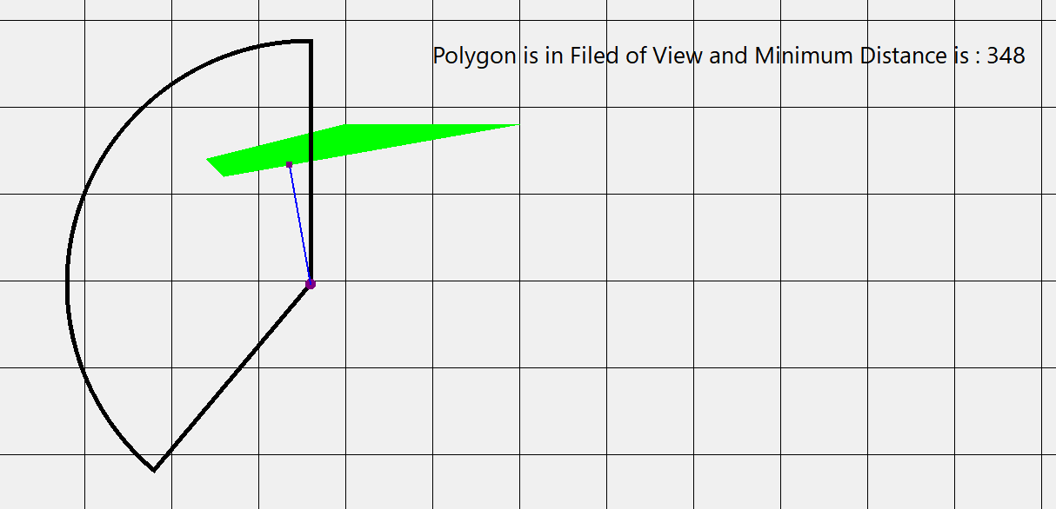
Example 2

Slide 9
Bonus
SENSOR

Slide 10
Optimizing Geometric Computations in Sensor Data:
Step 1: Objective
Efficiently identify relationships between arcs and point sets.
Step 2: Methodology
Approximate arcs as rectangles.
Approximate point sets as rectangles.
Step 3: Checks
Use bounding box and distance metrics for 'within-range' evaluations.
Step 4: Approaches
Algorithmic: Bounding box, Quadtree
Computational: Vectorization, Parallelization
Step 5: Significance
Reduce computational time.
Enable real-time processing.

Slide 11

Presented by:
Mostafa Mohamed Kamal
Omar Ahmed Mohamed
Omar Saad EL-Gharbaway
Osama Mahmoud
Ahmed Kamal
Ahmed Mousa

